Slide 1





RuxaiLab
Sentiment Analysis for
Usability Tests
GSoC 2024
Meet #3: Ver.#1 Sentiment Analysis (Roberta)
Presented By: Olivia Wilson
14-06-2024 16:00 (UTC+3)

Slide 2

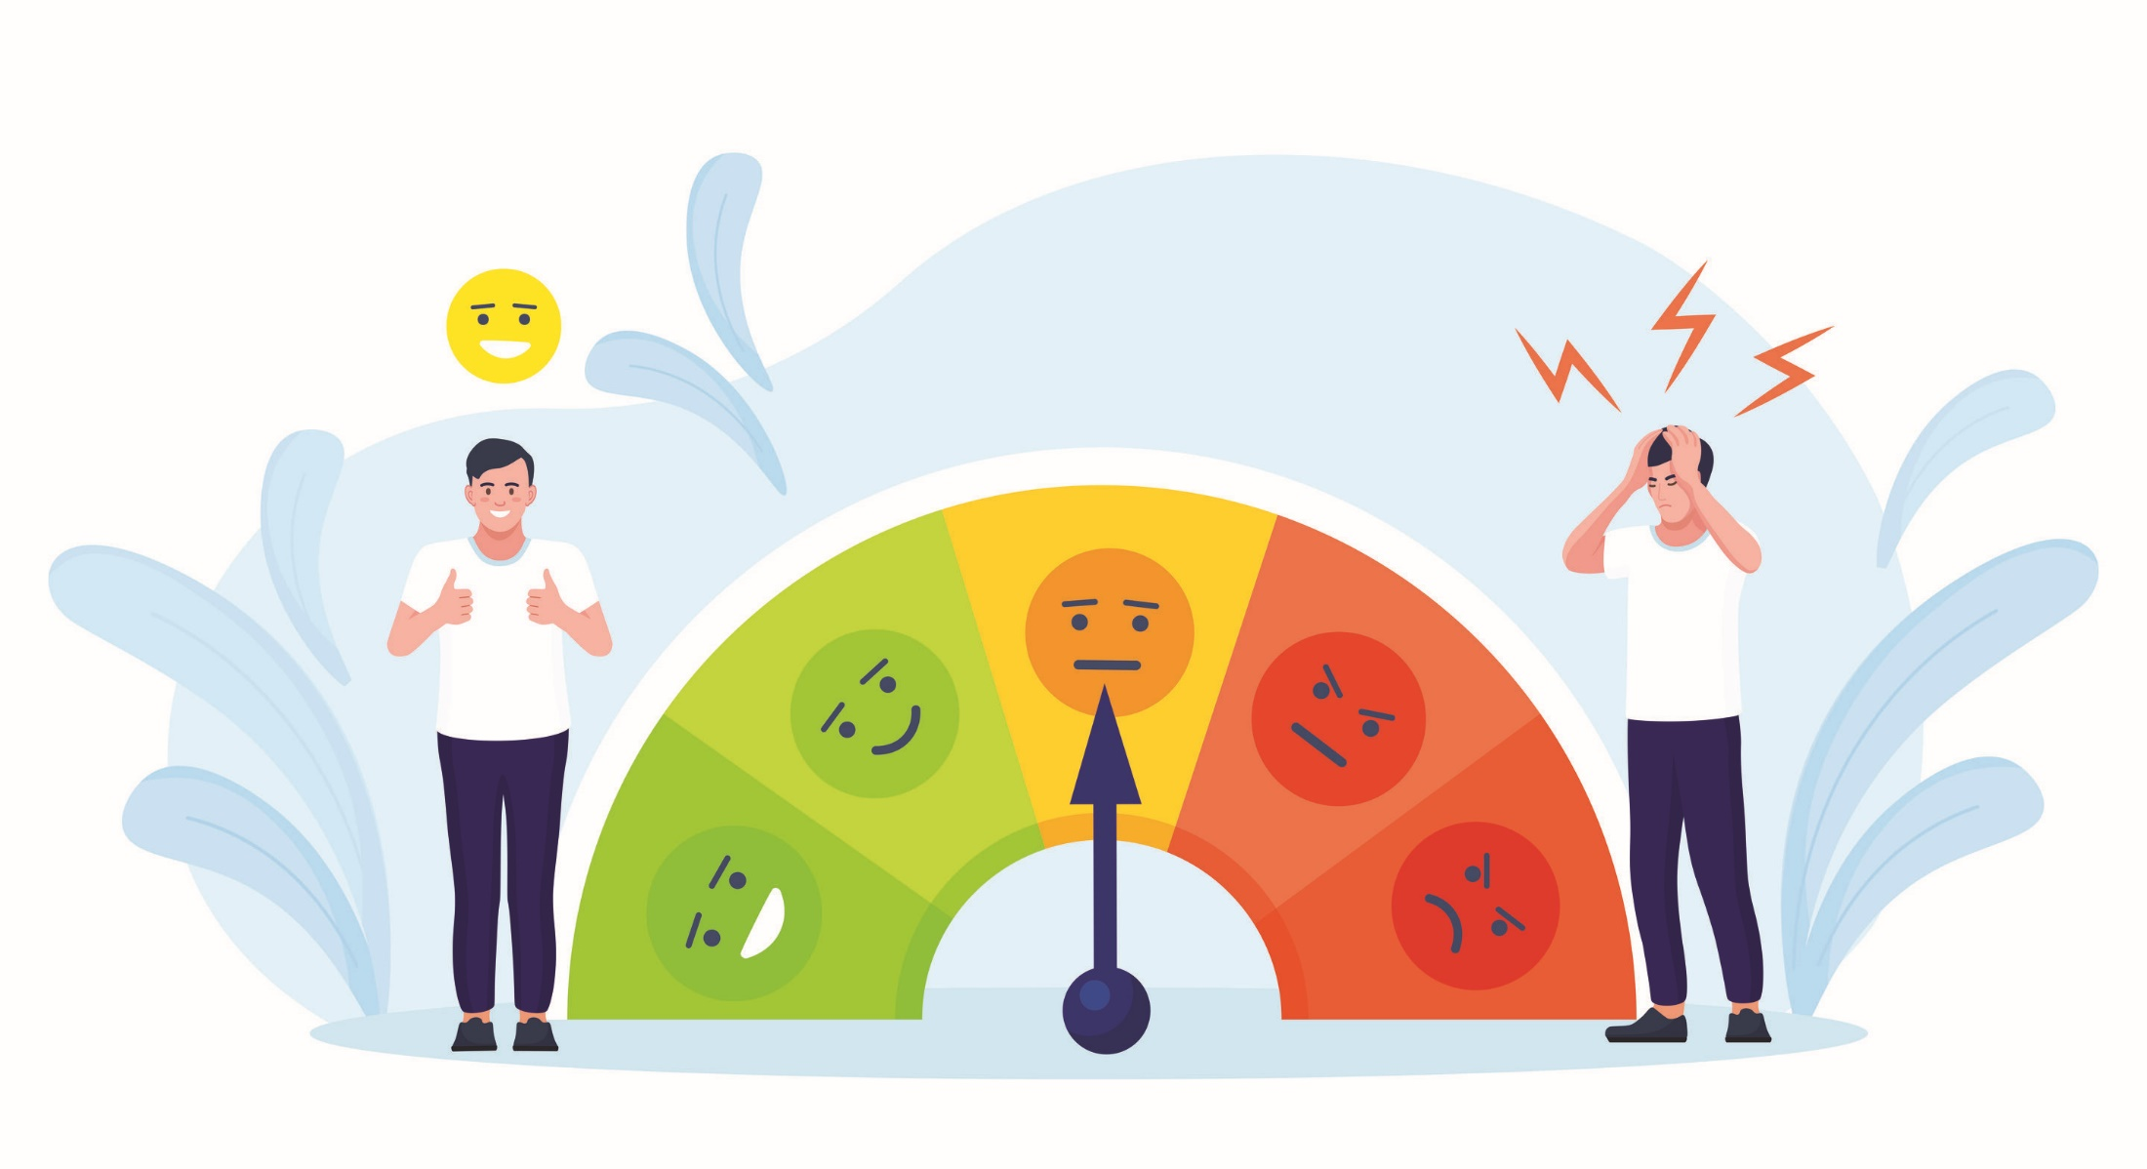
Agenda
Sportify Demo Video
Version #1
Next Steps
Questions To Mentors
Coding
Docs
Feedback

Slide 3


Sportify Demo Video
Notes:
Non-related utterances at the beginning of the video
Session is interrupted by another third person
Useful insights the last few minutes
Solutions:
Non-related 🡺 To be Classified As Neutral (To Be Tested)
Interruption 🡺 Real use case ☹ Add instruction for the user to be in a quite place

Slide 4

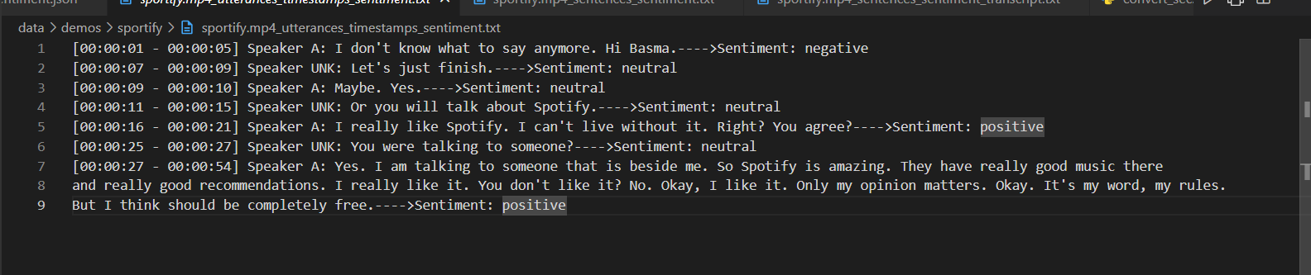


Version #1
Our first Sentiment Analysis Model
Say Hello!! to Our first Sentiment Analysis Model
Notes:
The last couple of mins

Slide 5
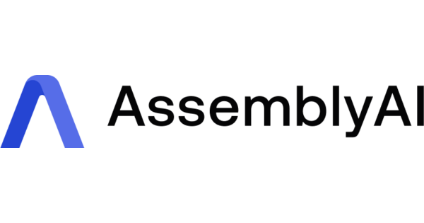
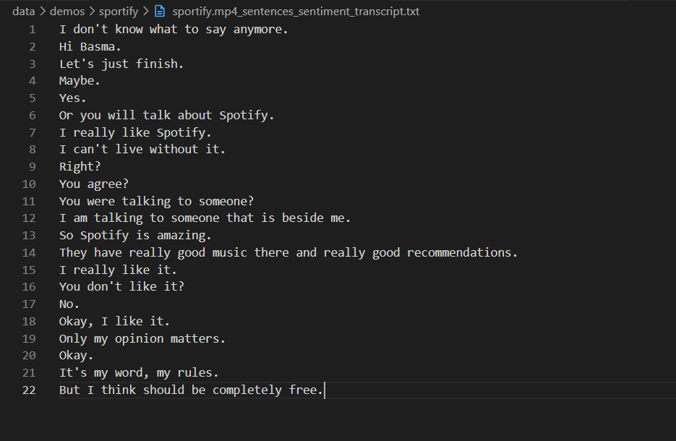
Version #1 (Speech2Text)
No Speakers
Assembly AI transcriber [here]
Notes:
The last couple of mins

Slide 6
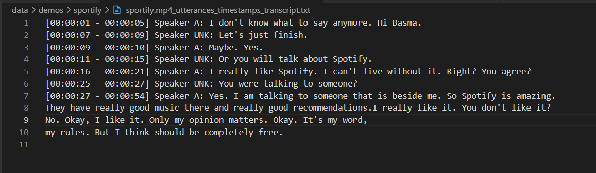
Version #1 (Speech2Text)
Utterances
Assembly AI transcriber [here]
Notes:
The last couple of mins

Slide 7

Version #1 (Speech2Text)
Problems:
User Plan
Very Slow Api 🡺 13 sec for 3s video audio
Couldn’t transcript long video
Solutions:
Check another free API + more real time
Check AI Model 🡺 local inference not API [CHECK]
Send chunk by chunk to the API 🡺 out-of-order speakers [CHECK ]
Assembly AI transcriber [here]
Notes:
The last couple of mins

Slide 8

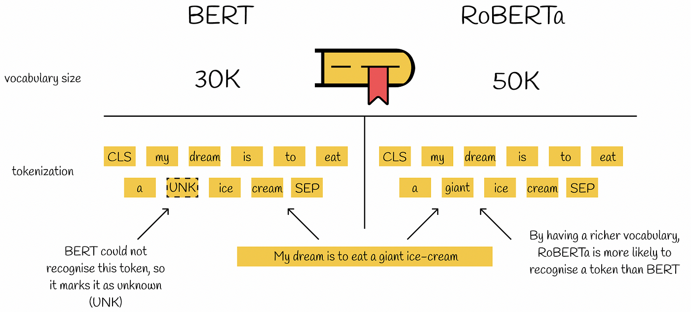

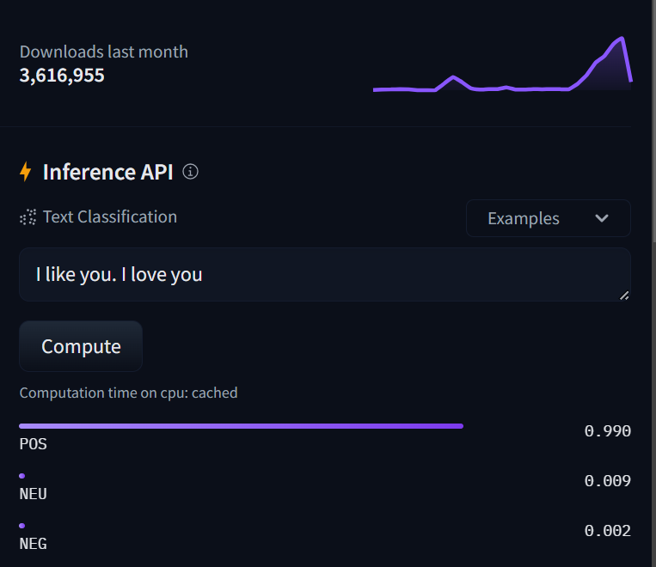

Version #1 (Sentiment Model)
BERT Variant
Fined Tuned on SemEval-2017 Task#4 (Tweets)
Bertweet Model [here]
Notes:
Roberta Variant form BERT
Fined Tuned on SemEval-2017 Task#4 (Tweets)

Slide 9
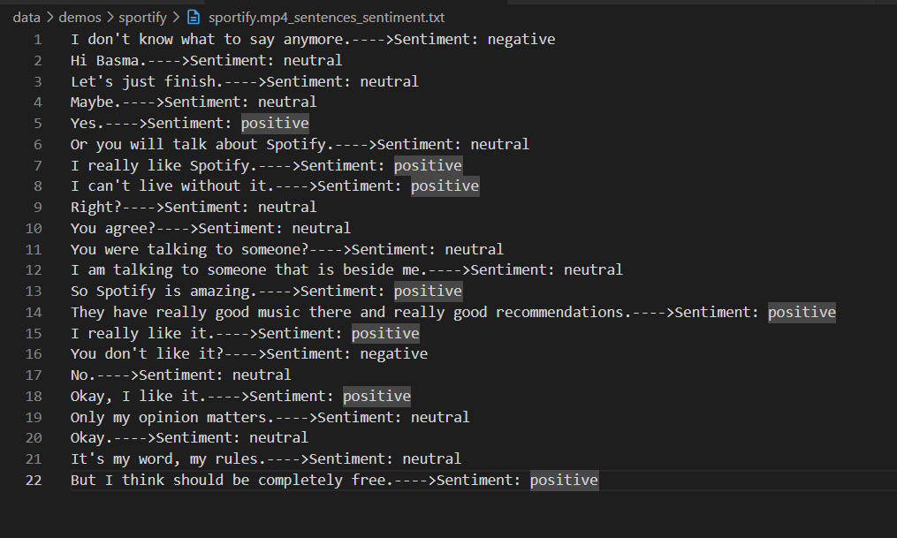
Version #1 (Sentiment Model)
No Speakers
Bertweet Model [here]

Slide 10
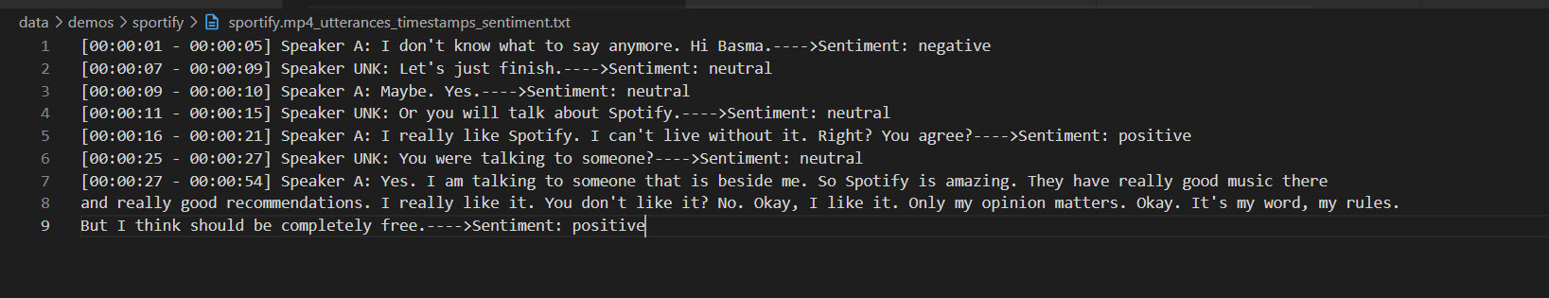
Version #1 (Sentiment Model)
Utterances
Bertweet Model [here]

Slide 11
Version #1 (Sentiment Model)
Problems:
Just Simple Version #1
Check Timing for sentiment model
Solutions:
To Be Improved 🡺 Baby steps move mountains :D
Bertweet Model [here]

Slide 12

Next Steps
New Tasks:
Study The Speech2Text Approach for better time
Fine Tunning Roberta Model on different Scenarios. (Synthetic Data or Google Play Data)
Trying Classical Approaches
Add Context in the Sentiment Analysis (MELD dataset)

Slide 13

Questions To Mentors
Problems:
Real-time sentiment Processing or offline
More video with real users for systems they don’t know a lot (Ask Community For Help :D)
Current System Deployment (google cloud)
Deploy Model inside UI
Interface with API
Integration with Video by Sebastian

Slide 14


Coding
Files:
Speech2Text: audio_to_text.py
Sentiment Model: roberta_predict.py
Notebooks for EDA Analysis: [Still]
Check More Files [here]

Slide 15
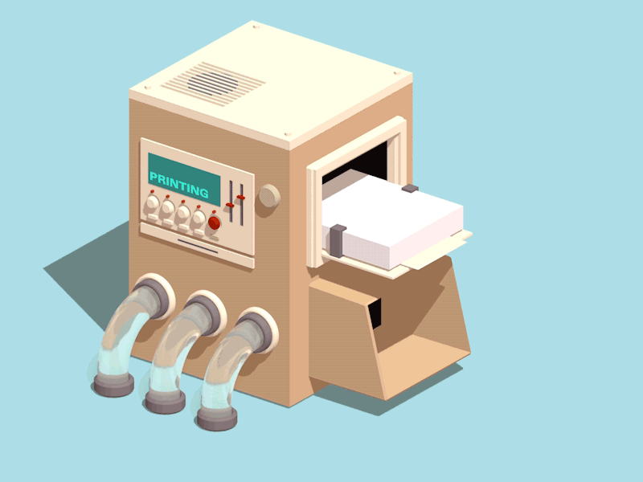
Docs
Documentations:
Comments added for code: [here]
Any Ideas ?!
Follow Up Sheets: [here]
Progress
2-day log
Meetings logs
Project Timeline
Presentations:
All these presentations are uploaded [here]

Slide 16


Feedback
Give me your Feedback about progress till now &
Next Steps
Small notes = Great Work

Slide 17





Thank you
Any Questions?
BasmaElhoseny01
basmaelhoseny01
basmaelhoseny6@gmail.com

Slide 18

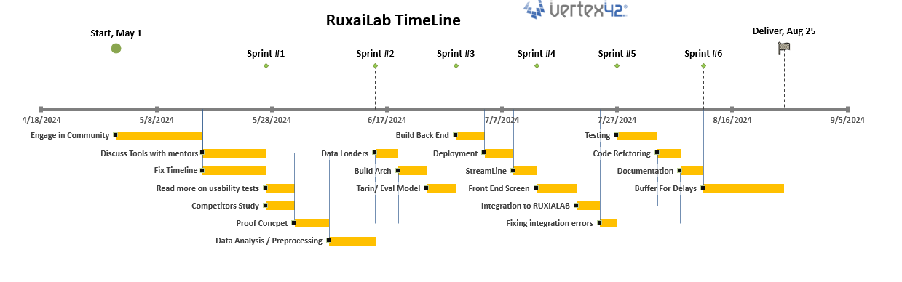
Timeline

